Slide 1

Exception Subprocess in SAP CPI
June 2021

Slide 2
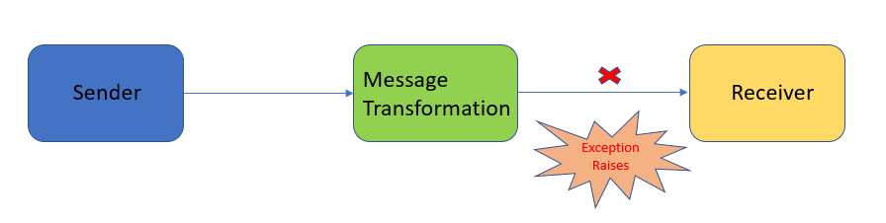
Exception:
During the execution of a message in Integration Flow, if any error occurs at runtime an exception raises and the normal execution of the flow disrupts.
The object exception, contains information about the error, including its type and the state of the program when the error occurred.
This exception can be raise at any point of time in message flow like during sender/receiver system connectivity or message transformation or a condition failure at runtime.

Slide 3
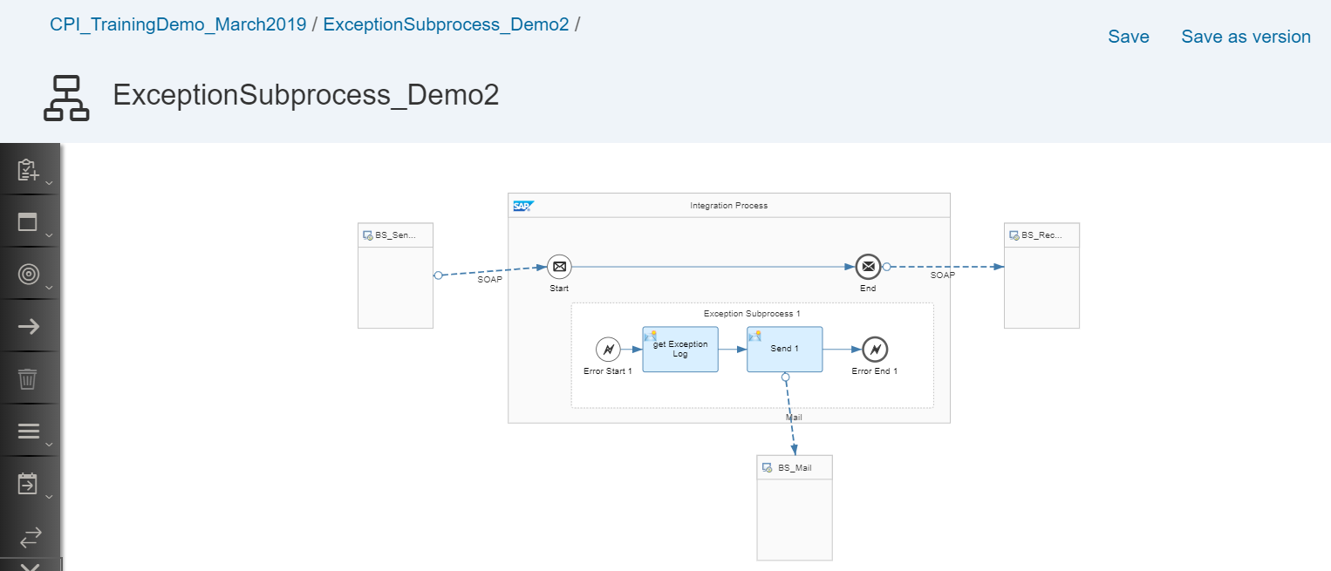
Integration Flow
An integration flow is a graphical representation of how the integration content can be configured to enable the flow of messages between two or more participants using SAP Cloud Platform Integration, and thus, ensure successful communication.

Slide 4
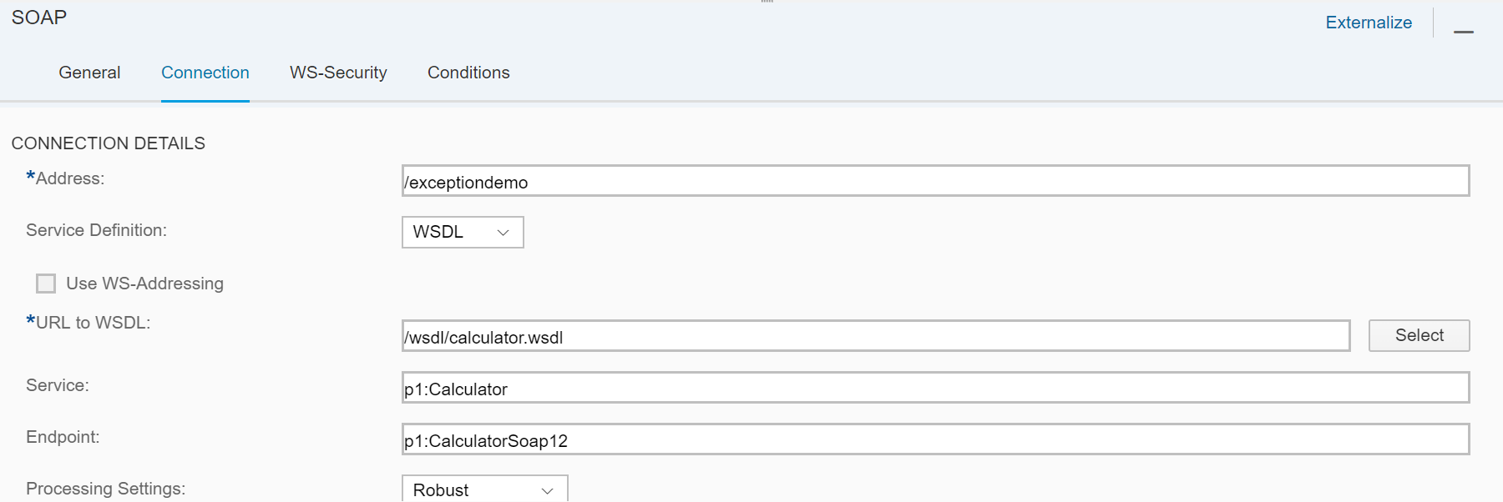
Configuration of Sender Channel
This address should be unique for creation of endpoint URL. If the address already exists in SCPI then design time error will occur. For this interface we are providing /exceptiondemo as address.
Select Service Definition as WSDL and then select the WSDL from local desktop in URL to WSDL tab

Slide 5
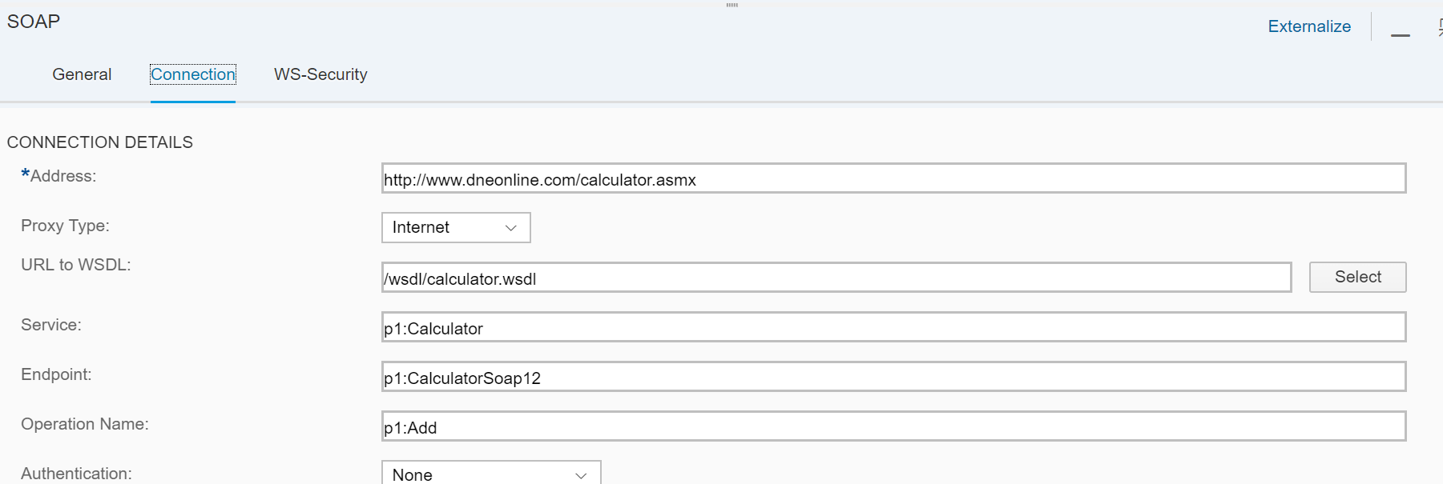
Configuration of Receiver Channel
Create a receiver SOAP channel with endpoint of the webservice. Provide the proxy type and select WSDL from the local file directory. Once WSDL selected, rest fields like Endpoint, Operation Name will populate automatically.
select the Authentication type as per requirement.

Slide 6
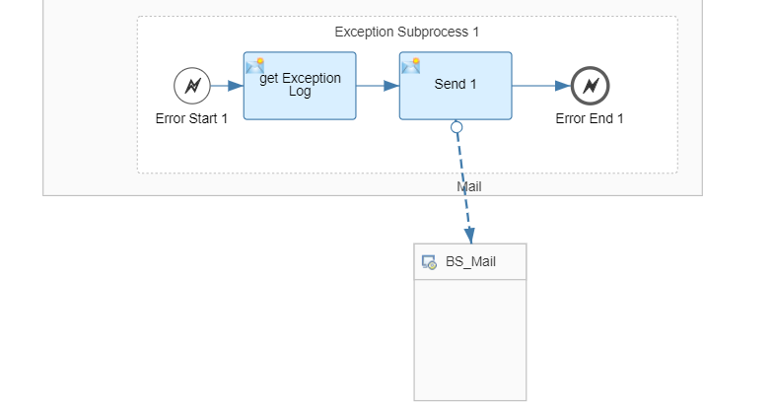
Exception SubProcess
Exception subprocess which we will place in iflow for triggering alerts if any exceptions

Slide 7
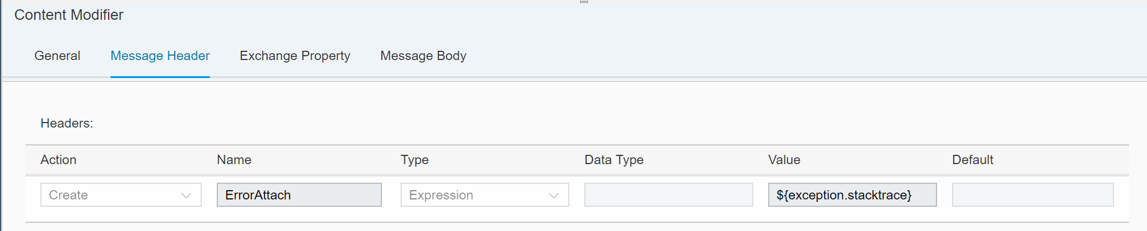
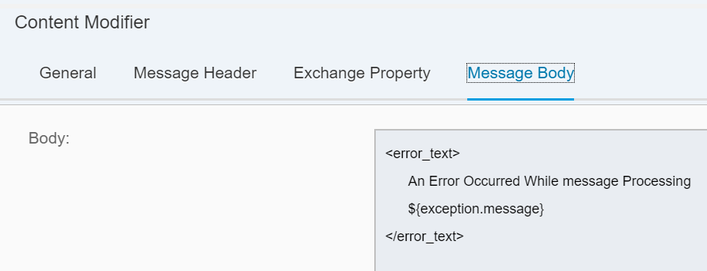
Content Modifier
Entries of Content modifier’s Message Header and Message Body. This content modifier is to prepare message of exception.

Slide 8
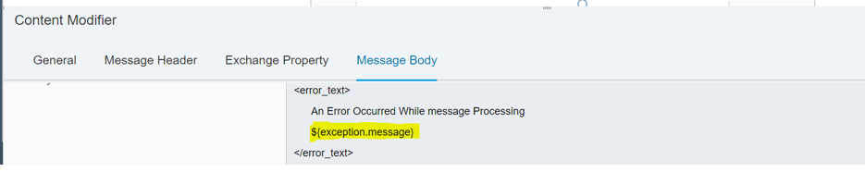
Contd..1
The highlighted expression in the above screenshot is the key point for handling exception.
It is camel expression. Apache Camel is an open source integration framework which SAP supporting in SCPI.
exception is a handler object which create when an error occurs at runtime. The exception message can be logged using ${execption.message}
Also, the stack trace can be logged with below camel expression.
${exception.stacktrace}
The message body can be customized as per requirement.

Slide 9
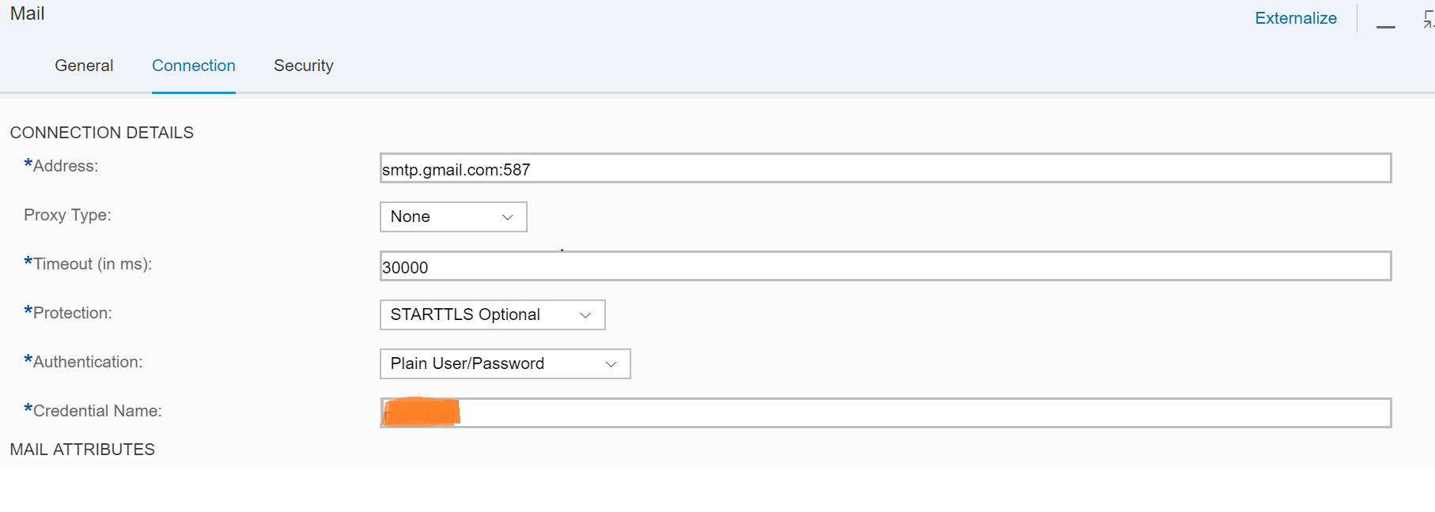
Configuration of Mail Receiver Channel
Below Fields are mandatory for triggering mail:
Address – Host Name of the Mail server
Proxy Type - Select if any
Protection: STARTTLS Optional
Authentication: Select the Authentication Type

Slide 10
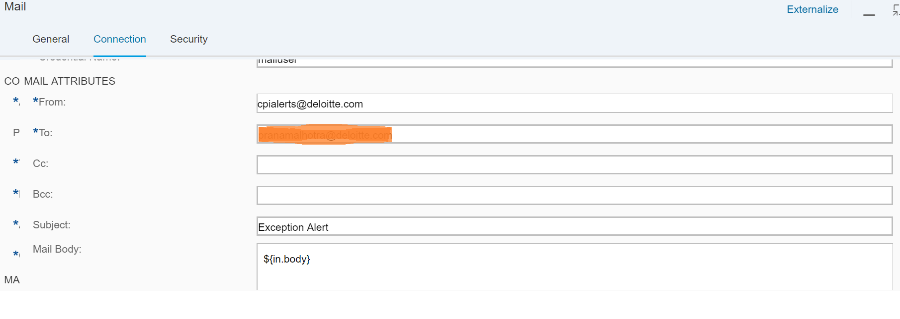
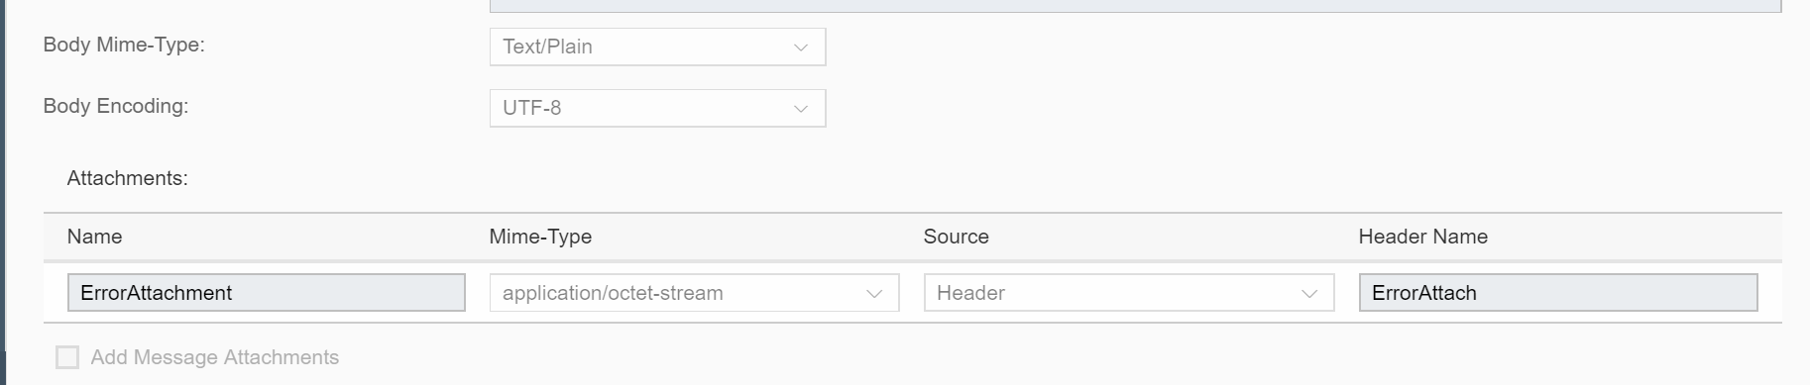
Contd..1
Configure Mail attributes like From Address, To Address and Attachments are optional

Slide 11
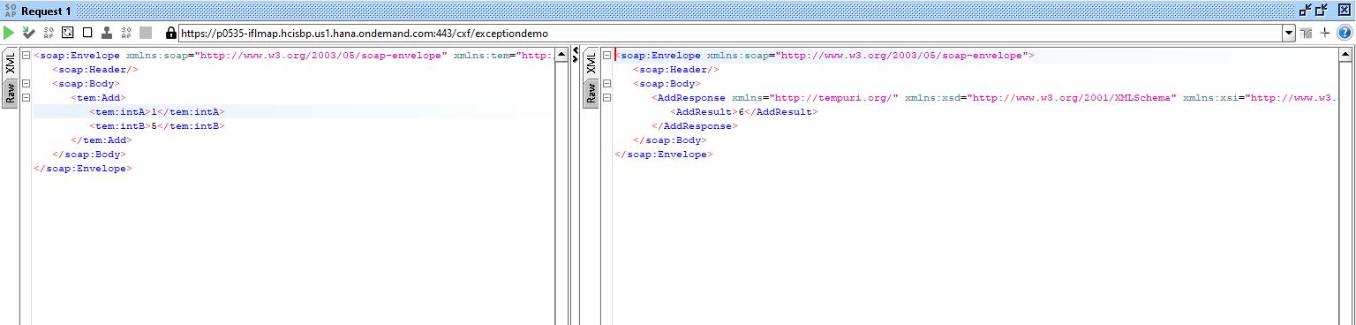
Test Using SOAPUI
Copy the URL from the above screen in SCPI.
Now create a new SOAP project and copy the endpoint and add ?wsdl as below. Now click on the Add operation and subsequent Request1 as below.
provide the input fields which are mandatory. If configuration in SCPI is correct then response looks below.

Slide 12
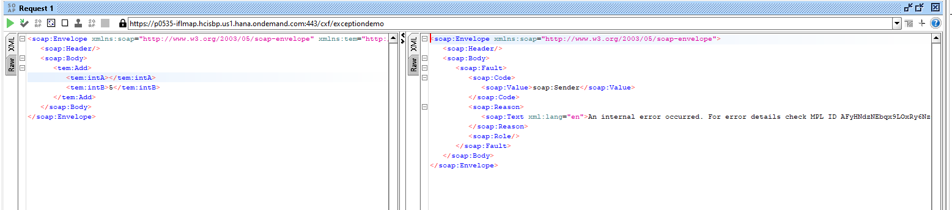
Contd..1
Now Provide only one field input value, then exception raises as both the fields are mandatory. The SOAP response contains the fault string thrown by the webservice.

Slide 13
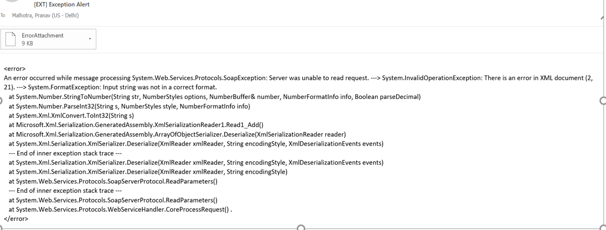
Alert Notification in Mail

Slide 14

About Deloitte Deloitte refers to one or more of Deloitte Touche Tohmatsu Limited, a UK private company limited by guarantee, and its network of member firms, each of which is a legally separate and independent entity. Please see www.deloitte.com/about for a detailed description of the legal structure of Deloitte Touche Tohmatsu Limited and its member firms. Please see www.deloitte.com/us/about for a detailed description of the legal structure of Deloitte LLP and its subsidiaries. Certain services may not be available to attest clients under the rules and regulations of public accounting. Copyright © 2013 Deloitte Development LLC. All rights reserved. 36 USC 220506 Member of Deloitte Touche Tohmatsu Limited
Notes:
14

